Slide 1
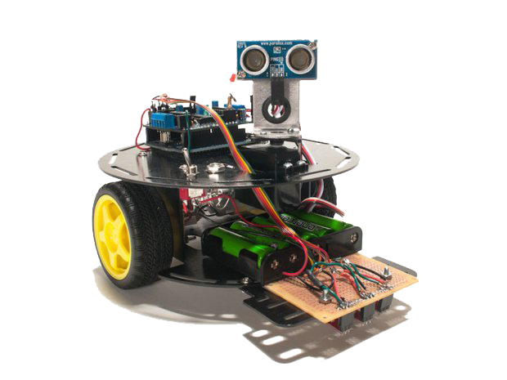

Boian Mitov
Programming Arduino Robots with Visuino
Mitov Software
mitov@mitov.com
www.mitov.com

Slide 2
What is Arduino from a hardware point of view
Low cost open source hardware micro-controller board
Resilient difficult to damage hardware
Huge number of clones and boards new coming every day
Simple to use for hardware designs
Very good for real time tasks

Slide 3
What is Arduino from a software point of view
A uniform development environment and API for multitude of platforms
Supported by many non “Arduino” based devices such as Teensy, Edison, Galileo, Curie, Femto.IO, ESP8266, FreeSoc2, and many more...
Allows easy code sharing between different hardware platforms

Slide 4
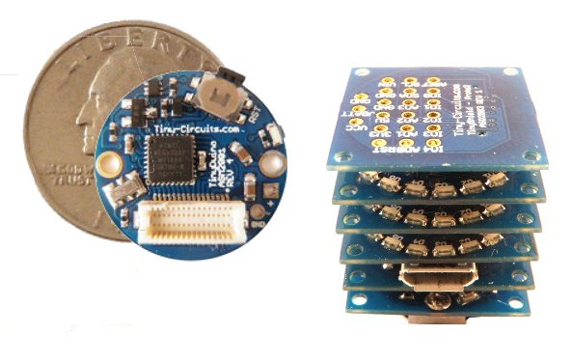
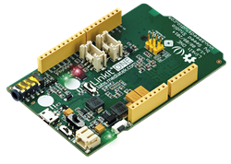
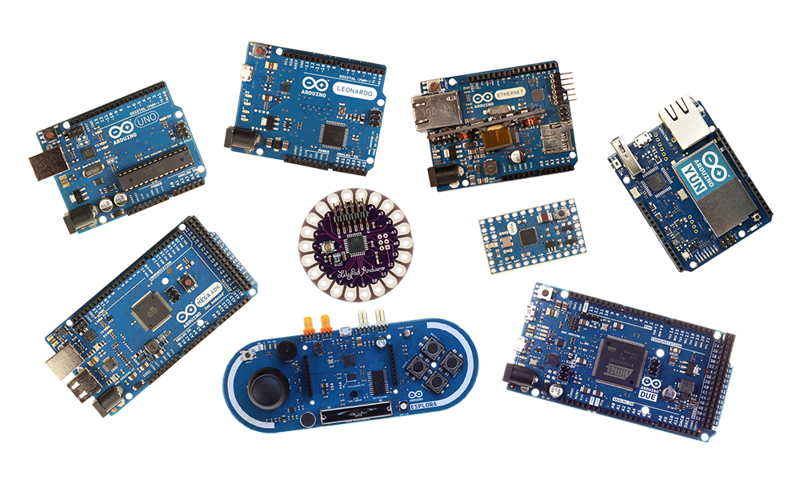
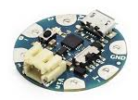
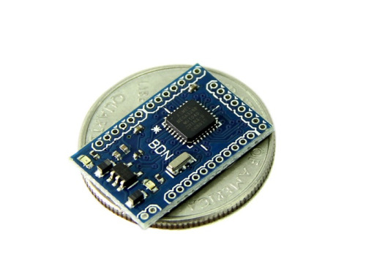
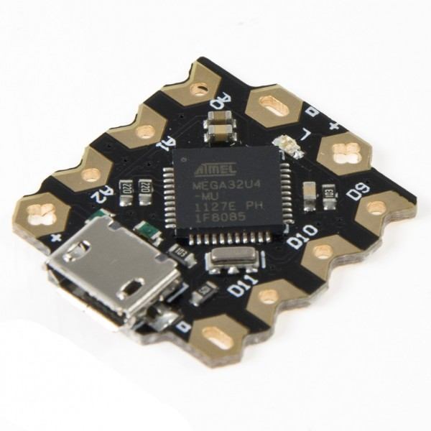
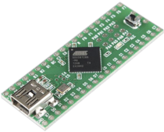
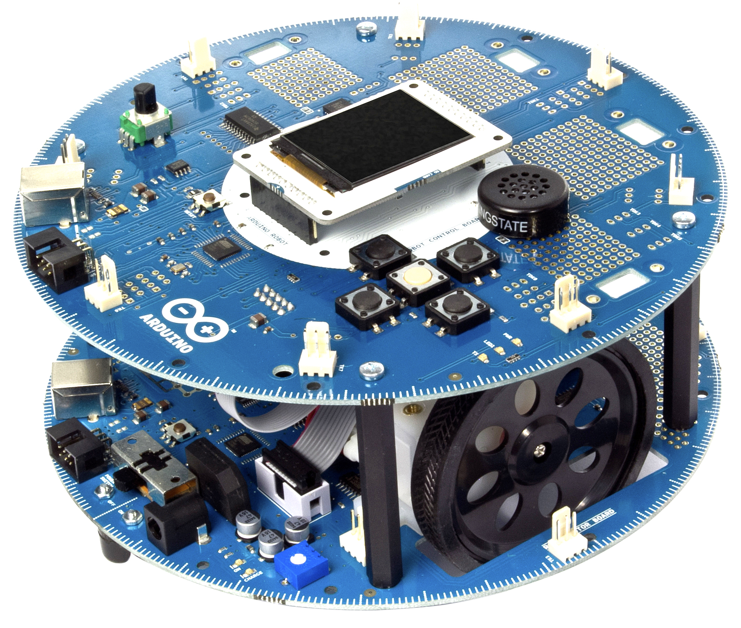
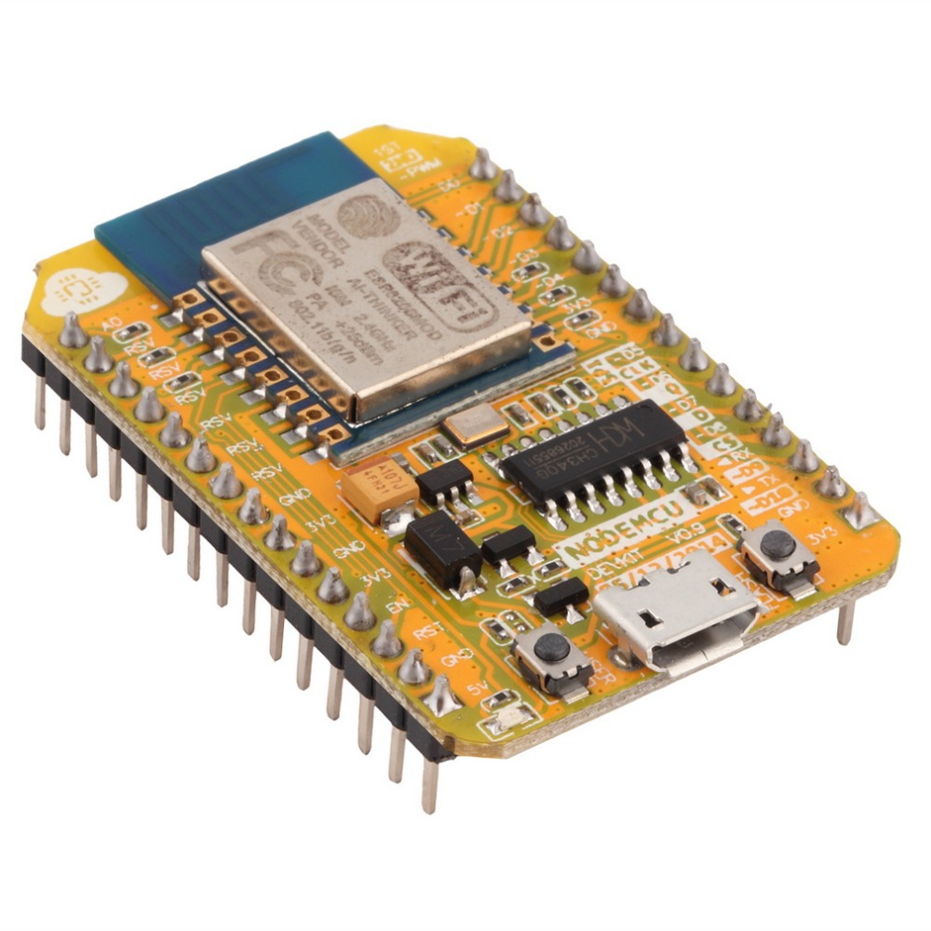
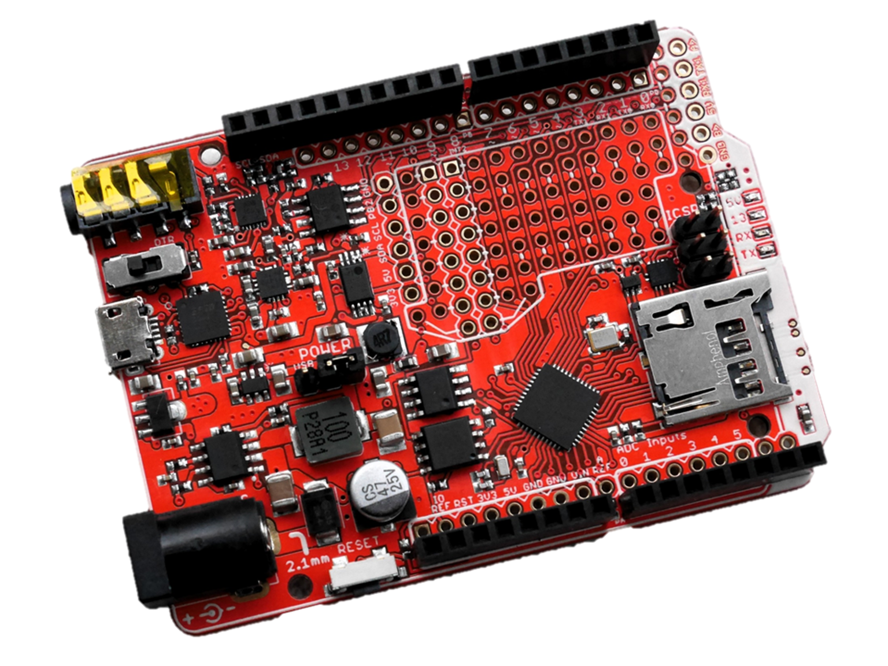
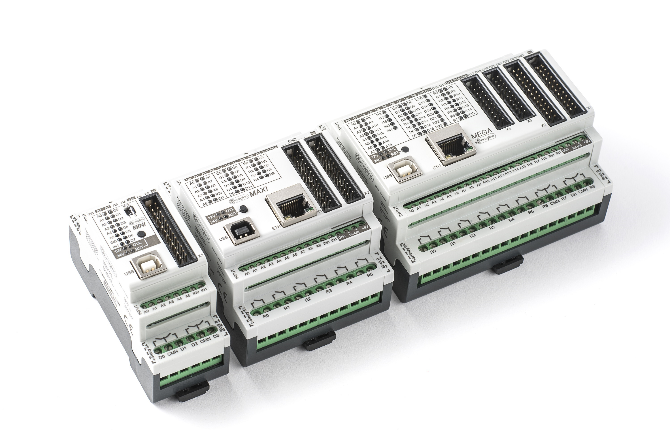
Examples

Slide 5
Why use Arduino for IoT
Very low cost, some devices as cheap as $2 or less
Large number of digital and analog channels
Large number of connectivity options over Ethernet, WiFi, Bluetooth, GSM/GPRS and many others...
Large variety of sizes starting with a small coin size to a palm size boards
Large amount of available peripherals

Slide 6
What are the Arduino challenges?
Very primitive and cumbersome development tools, difficult to learn and use
Requires relatively low level programming
Most people have no problem connecting hardware to it, but they get lost in the programming side
Lack of easily available debugging tools
When used for collecting data, there is no easy way to visualize it
No readily available tools to communicate with it from Delphi or C++ Builder

Slide 7
Visuino comes to play
Graphical development environment for Arduino
Automatically generates Arduino code, and programs the boards
Built in data visualization
Direct mapping of software and hardware components
Provides uniform communication over serial, or socket based channels
Includes serial port, and socket communications components compatible with CommunicationLab for Delphi and C++ Builder

Slide 8
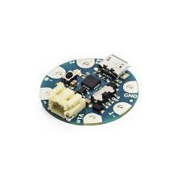
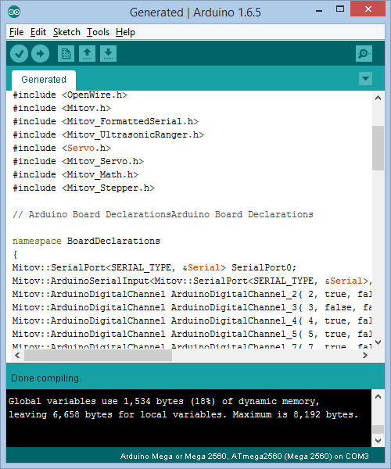
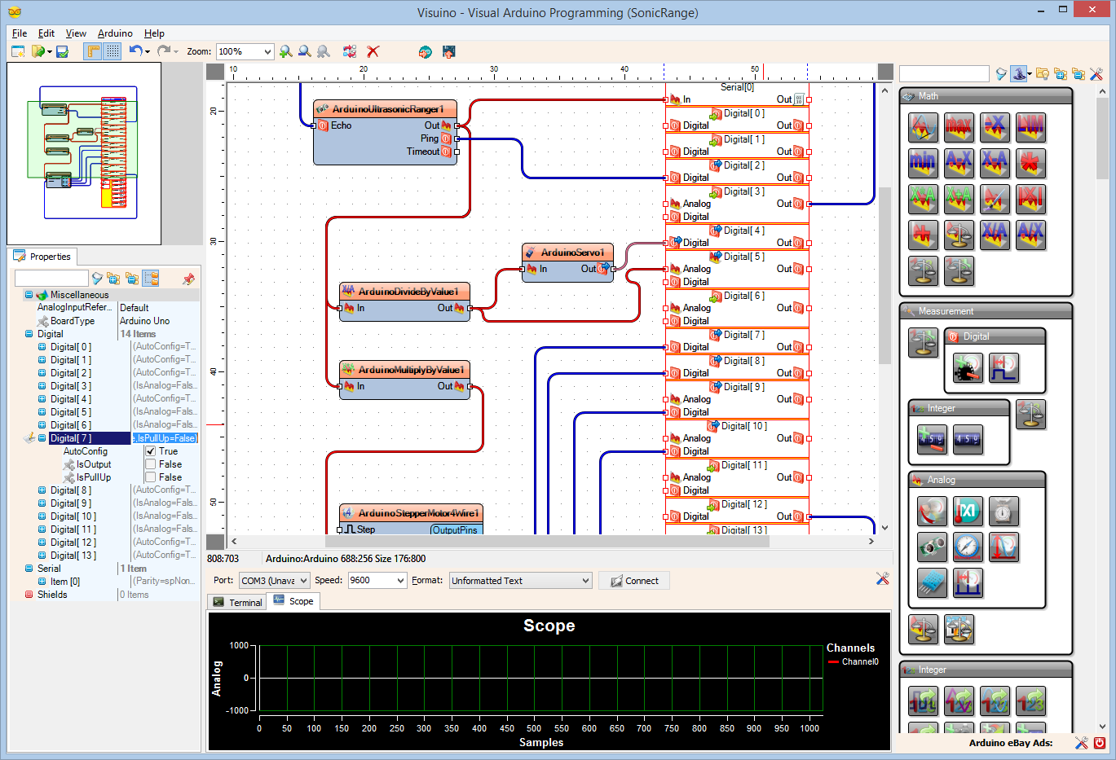

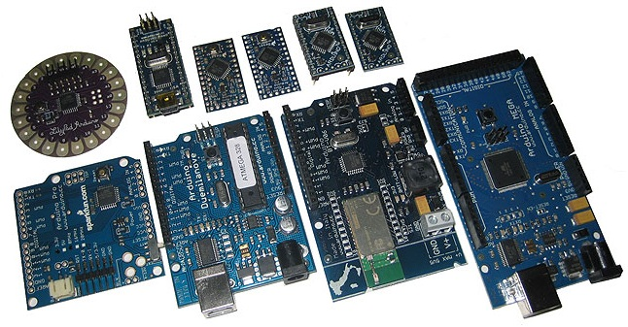
How Visuino works

Slide 9
Integration with the rest of the Mitov Software solutions
Communication
Delphi
OpenWire Studio
Visuino/Arduino
C++ Builder
.NET
Visual C++

Slide 10
About the Speaker
Boian Mitov – President of Mitov Software mitov@mitov.com
Mitov Software – www.mitov.com products:
VideoLab – Video processing library
AudioLab – Audio processing library
SignalLab – Digital signal processing library
VisionLab – Computer vision library
PlotLab – Data visualization library
InstrumentLab – Visual instrumentation library
IntelligenceLab – Artificial intelligence library
LogicLab – Boolean logic library
AnimationLab – Universal animation library
CommunicationLab – Serial and TCP/IP Communication library
Visual Live Binding – Universal visual live binding library
Mitov.Runtime – Free Delphi library
OpenWire Studio – Graphical development environment for Windows
Visuino – Graphical development environment for Arduino
Free open source libraries maintained by Mitov Software:
www.openwire.org – The OpenWire library
www.igdiplus.org – The IGDI+ library ( Delphi friendly GDI+ library )

