Slide 1
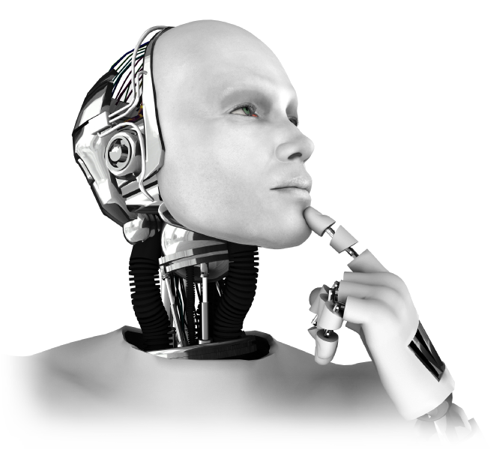
Boian Mitov
Artificial Intelligence with .NET
Mitov Software
mitov@mitov.com
www.mitov.com

Slide 2
Types of Artificial Intelligence
Expert systems (Early 80s)
Planning engines
Classifiers

Slide 3
Classifiers and feature extractors
Features are extracted from the data
The features are passed to classifier
The classifier detects conditions based on the features
Features
Conditions
Data
Data
Feature extractor
Feature extractor
classifier

Slide 4
Types of classifiers
Neural networks (including Perceptron)
Naïve(Normal) Bayes
Hidden Markov model
Kernel Methods
Support vector machine
k-nearest neighbor algorithm
Mixture model (including Gaussian mixture model)
Decision tree
Linear Classifier
Self Organizing Maps(including Growing self-organizing maps)
Generative Topographic Maps

Slide 5
Types of training for classifiers
Supervised training
Non supervised training
Self Organizing Classifiers

Slide 6
AI Classifier Applications
SPAM filtering
Computer vision
OCR
Speech recognition
Diagnostic utilities
Industrial control
Investment
Code formatting
Gesture recognition
Robotics
Games
Function approximation

Slide 7
Neural Networks
Simulates the way the brain works.
Consists of neurons.
Feedforward or Recurrent.
Usually uses backpropagation to train.

Slide 8
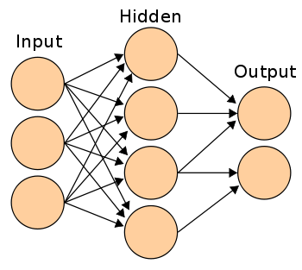
Feedforward Neural Network

Slide 9
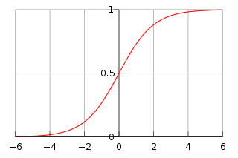
Neuron (with Sigmoid function)
X1
W1
W2
u
F(u)
y
X2
+
W3
X3

Slide 10
Recognizing images with AI
The images can have different orientation and position
Scanning technics are usually employed
Rotating the image and passing it trough classifier may produce unexpected results
It is better to train with rotated images

Slide 11
AI Training Challenges
More relevant features result in better prediction
The classifiers tend to require a lot of computing power
Selecting a good training set is very important

Slide 12
Speeding up the classifiers
Parallel execution on multiple CPUs
Execute on GPU
Distributed execution on multiple system
Execute in FPGA

Slide 13
The business of AI
There is a constant demand for better classifiers, and implementations of existing classifiers
Training is intellectual property and a product of its own

Slide 14
About the Speaker
Boian Mitov – President of Mitov Software mitov@mitov.com
Mitov Software – www.mitov.com products:
VideoLab – Video processing library
AudioLab – Audio processing library
SignalLab – Digital signal processing library
VisionLab – Computer vision library
PlotLab – Data visualization library
InstrumentLab – Visual instrumentation library
IntelligenceLab – Artificial intelligence library
LogicLab – Boolean logic library
AnimationLab – Universal animation library
CommunicationLab – Serial and TCP/IP Communication library
Visual Live Binding – Universal visual live binding library
Mitov.Runtime – Free Delphi library
OpenWire Studio – Graphical development environment for Windows
Visuino – Graphical development environment for Arduino
Free open source libraries maintained by Mitov Software:
www.openwire.org – The OpenWire library
www.igdiplus.org – The IGDI+ library ( Delphi friendly GDI+ library )

